Slide 1
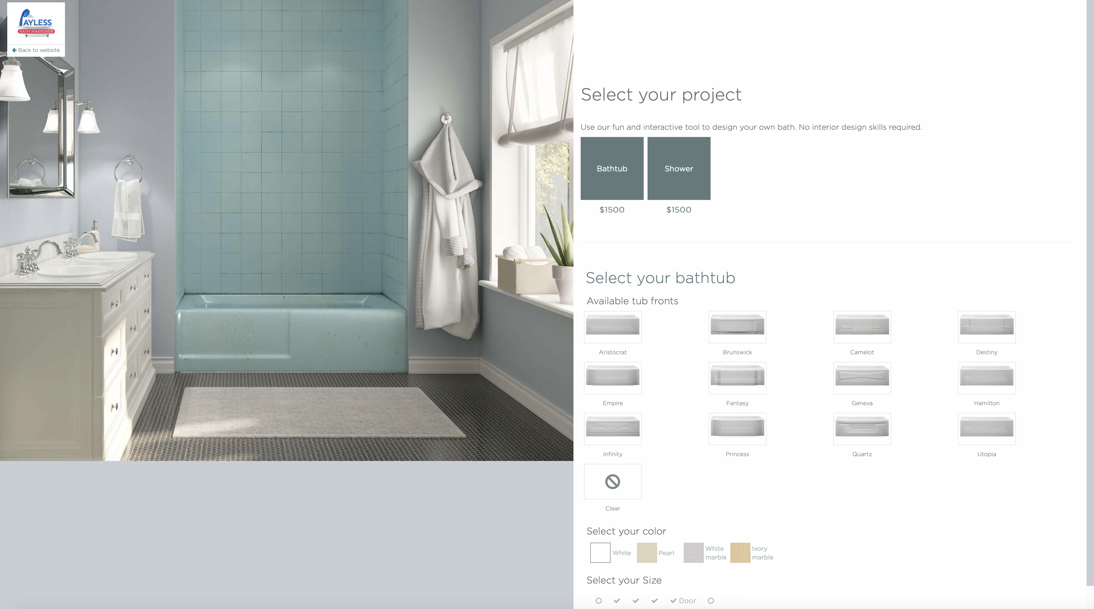

Corner Shower
Alcove Shower
Notes:
We will have 3 options to select from in the beginning – bath tub, corner shower, alcove shower

Slide 2
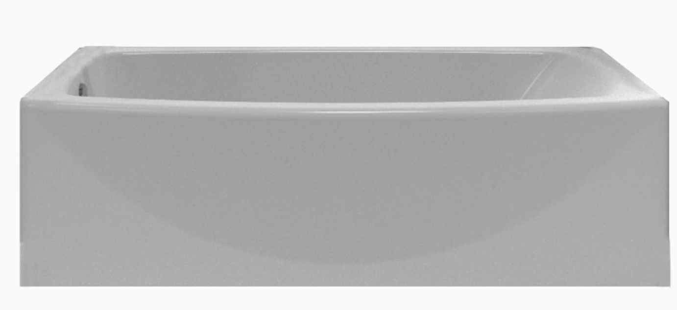
INCLUDED IN PACKAGE: TUB
INCLUDED –
29-in W x 60-in L White Rectangular Right-Hand or Left Hand Drain Alcove Bathtub

Slide 3

Corner Shower
Alcove Shower

Slide 4
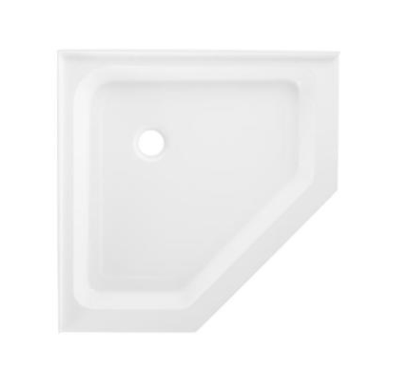
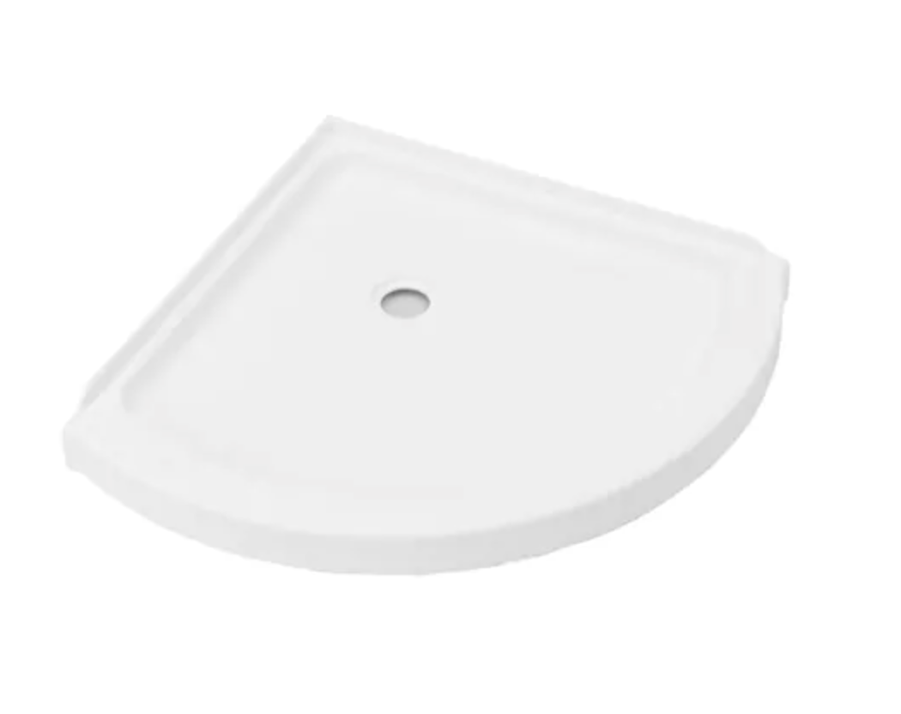
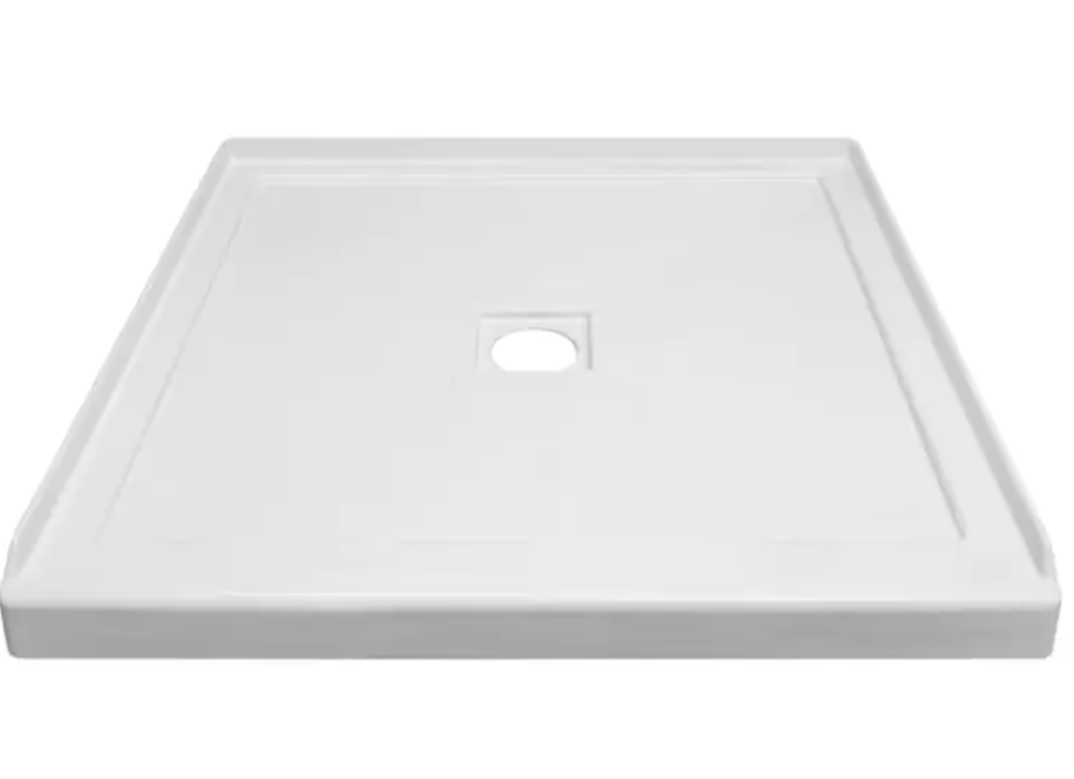
PAN – STYLE SELECTION
ALCOVE CORNER
NEO ANGLE
ROUND CORNER

Slide 5
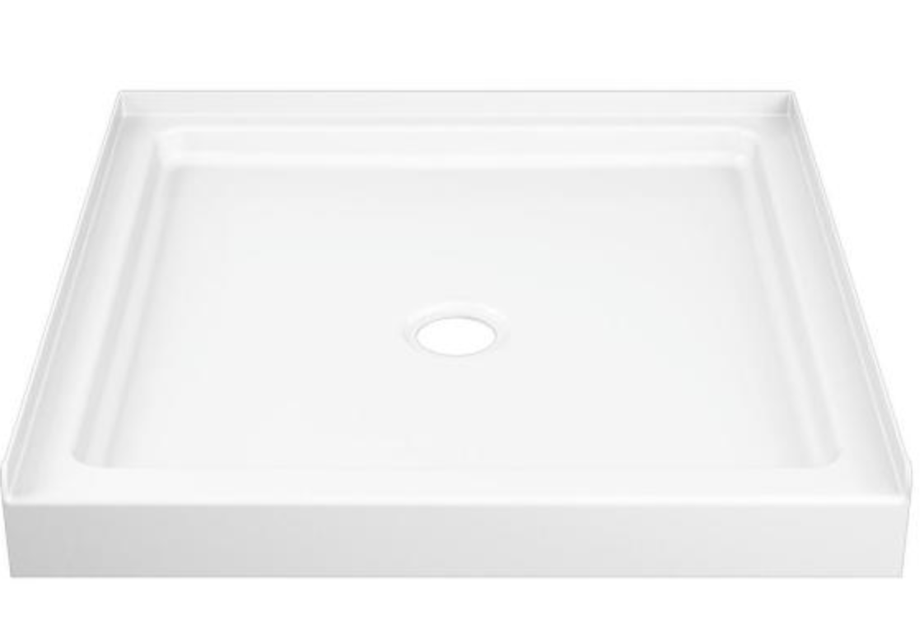
PAN – SIZE SELECTION – ALCOVE CORNER
ALCOVE 32x32
White Acrylic Shower Base 35.875-in W x 35.875-in L with Center Drain
ALCOVE 36x36
White Acrylic Shower Base 35.875-in W x 35.875-in L with Center Drain

Slide 6
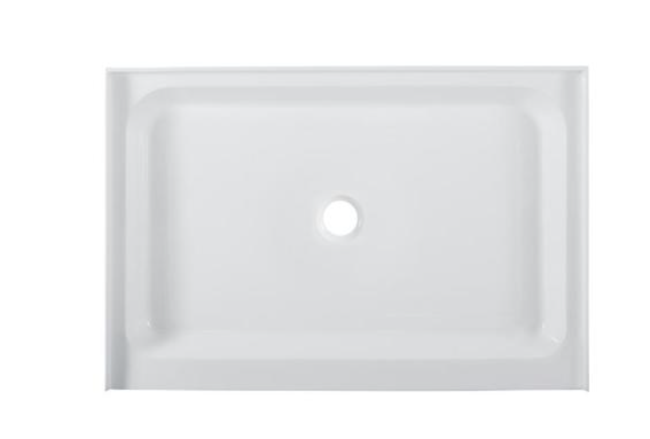
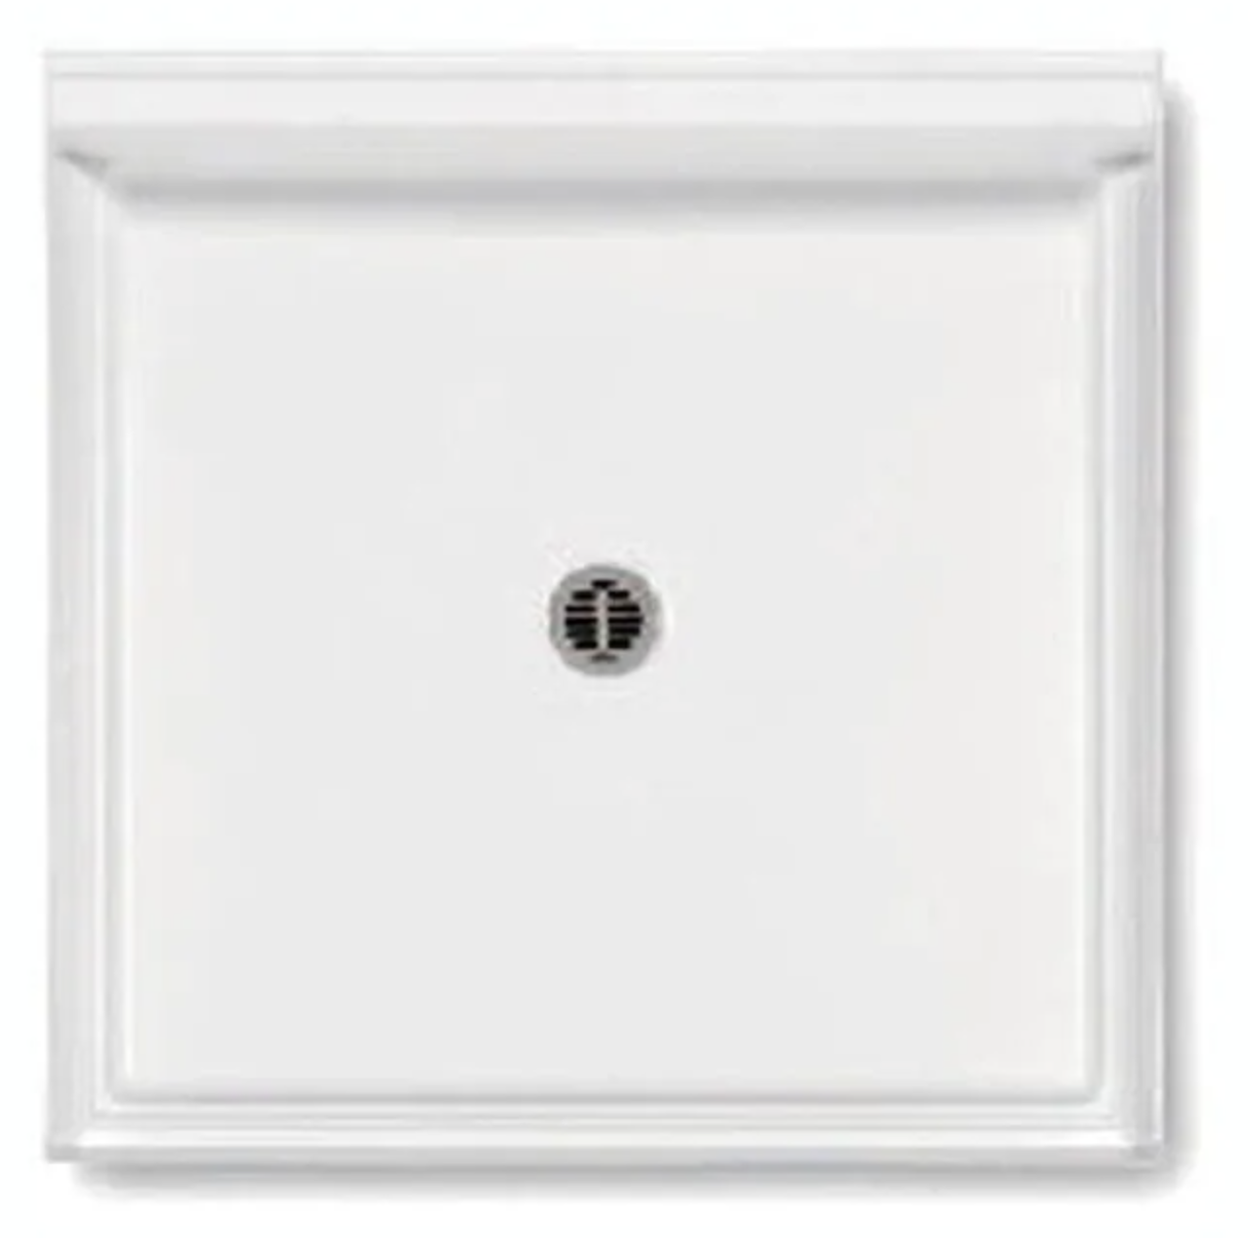
PAN – ALCOVE CORNER – UPGRADE LEVEL 2
42 in. W x 42 in. D Center Drain Single Threshold Shower Base in White
48 in. x 32 in. Acrylic White, Single-Threshold, Center Drain, Shower Base

Slide 7
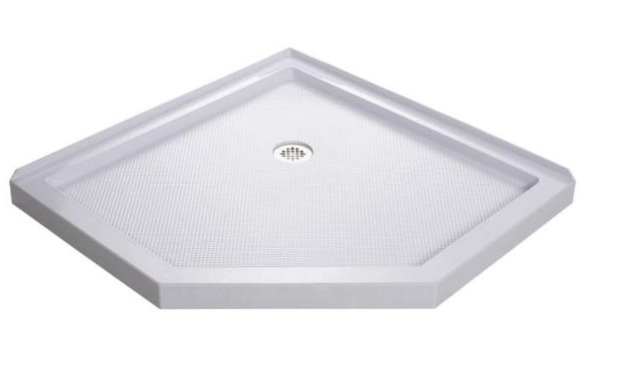
PAN – SIZE SELECTION – NEO ANGLE CORNER
Neo Angle 38x38
38 in. x 38 in. Neo-Angle Shower Tray in White
NEO ANGLE- 36x36
36 in. x 36 in. Acrylic White, Single-Threshold, Center Drain, Neo-angle Shower Base

Slide 8
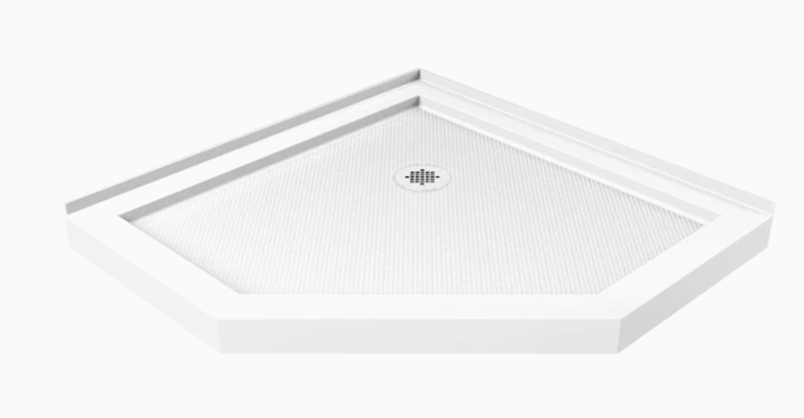
PAN – NEO ANGLE CORNER – UPGRADE LEVEL 2
42-in L x 42-in W White Acrylic Neo-Angle Corner Shower Base

Slide 9
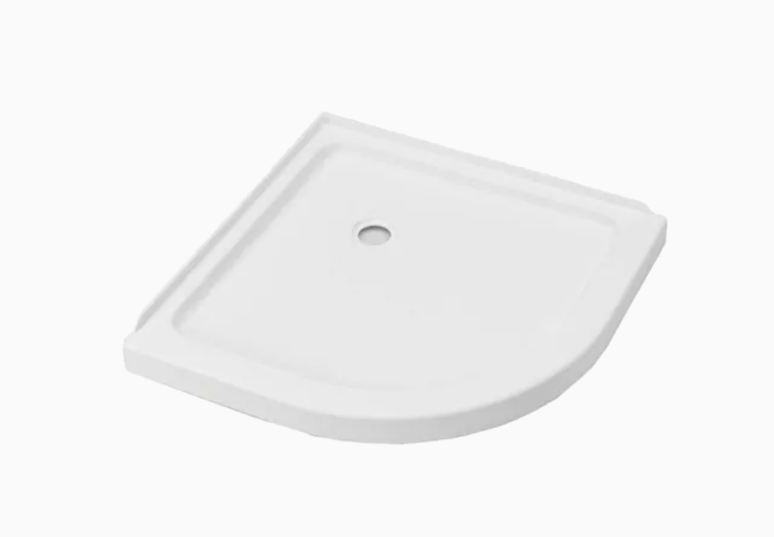
PAN – SIZE SELECTION – ROUND CORNER
ROUND CORNER 36x36
White Acrylic Shower Base 35.875-in W x 35.875-in L with Center Drain
ROUND CORNER 38x38
38-in L x 38-in W White Acrylic Round Corner Shower Base

Slide 10

Corner Shower
Alcove Shower

Slide 11
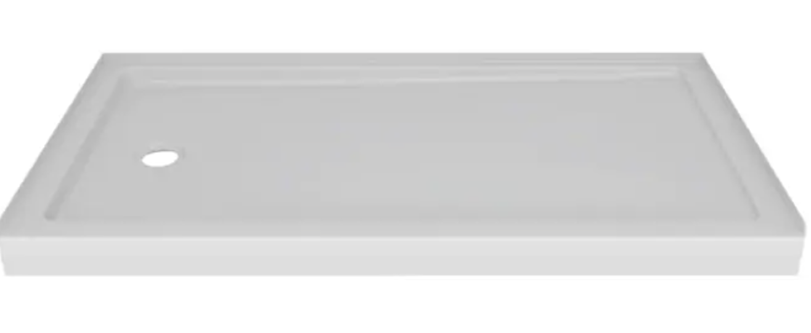
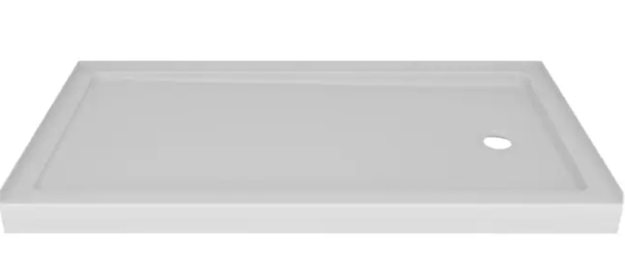
ALCOVE – INCLUDED IN PACKAGE
60x30
High Gloss White Acrylic Shower Base (Common: 60-in W x 32-in L; Actual: 59.875-in W x 30.75-in L) RIGHT OR LEFT DRAIN

Slide 12
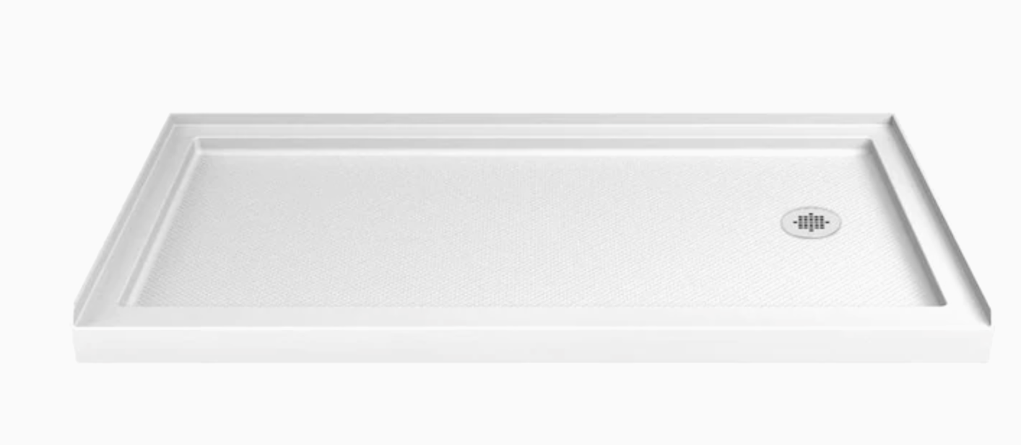
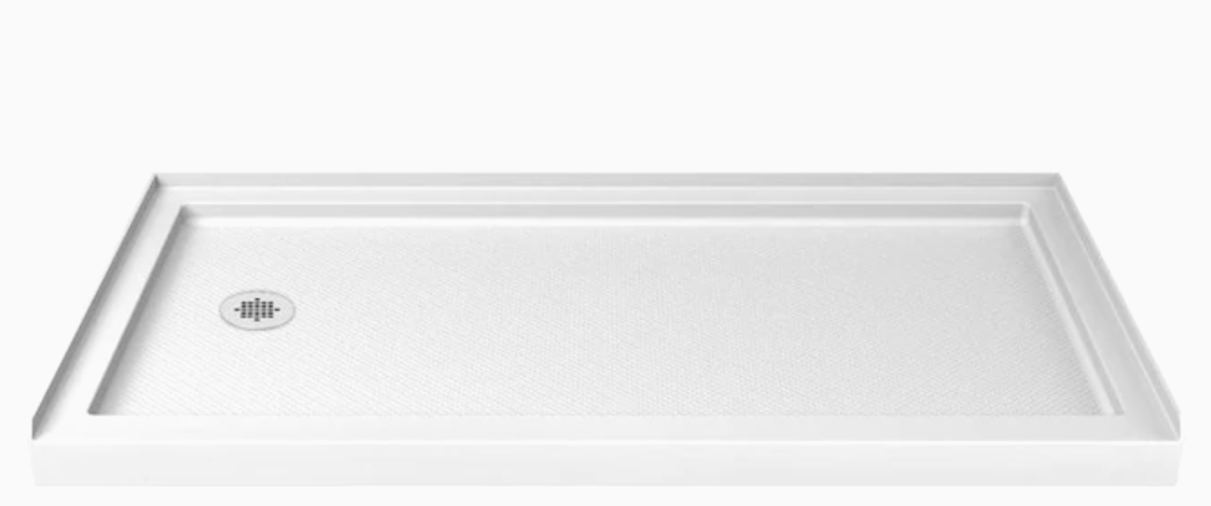
ALCOVE – UPGRADE
60X36
White Acrylic Shower Base 36-in W x 60-in L with Left or Right Drain

Slide 13



WALLS – INCLUDED IN PACKAGE
GRAY DIAMOND SIM TILE
ALMOND 8x10 SIM TILE
WHITE SUBWAY SIM TILE
Notes:
** PRE ORDER FROM BCI

Slide 14
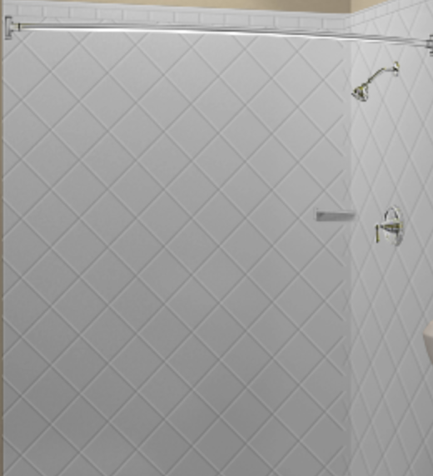
Gray Diamond

Slide 15
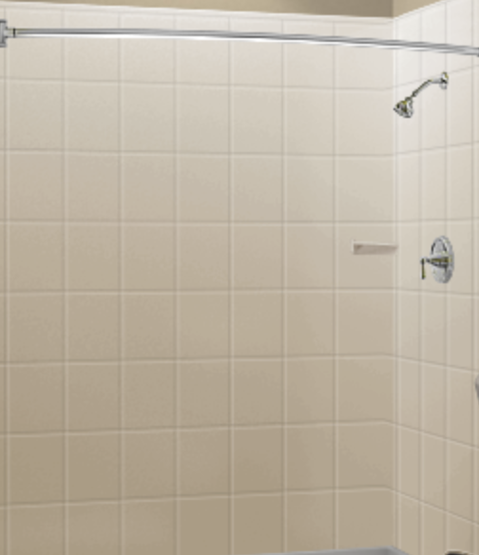
Almond 8X10

Slide 16
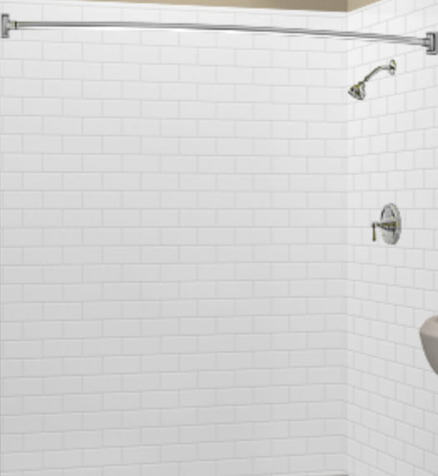
White Subway

Slide 17
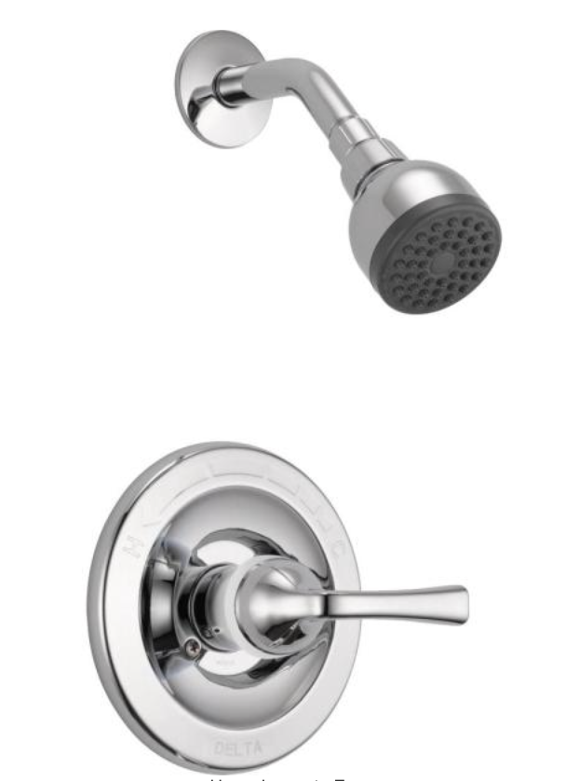
SHOWER PLUMBING FIXTURES – INCLUDED IN PACKAGE
INCLUDED -
Single-Handle 1-Spray Shower Faucet in Chrome (Valve Included)

Slide 18
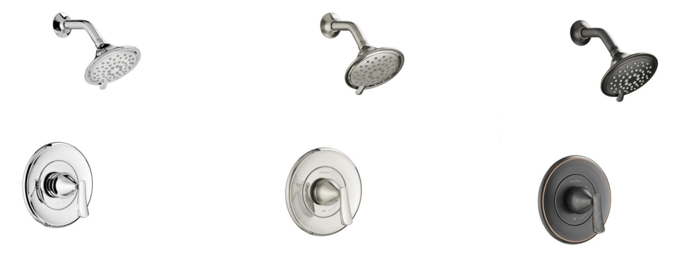
SHOWER PLUMBING FIXTURES – FREE UPGRADE
Single-Handle 3-Spray Shower Faucet in Chrome (Valve Included)
Single-Handle 3-Spray Shower Faucet in Brushed Nickel (Valve Included)
Single-Handle 3-Spray Shower Faucet in Legacy Bronze (Valve Included)

Slide 19
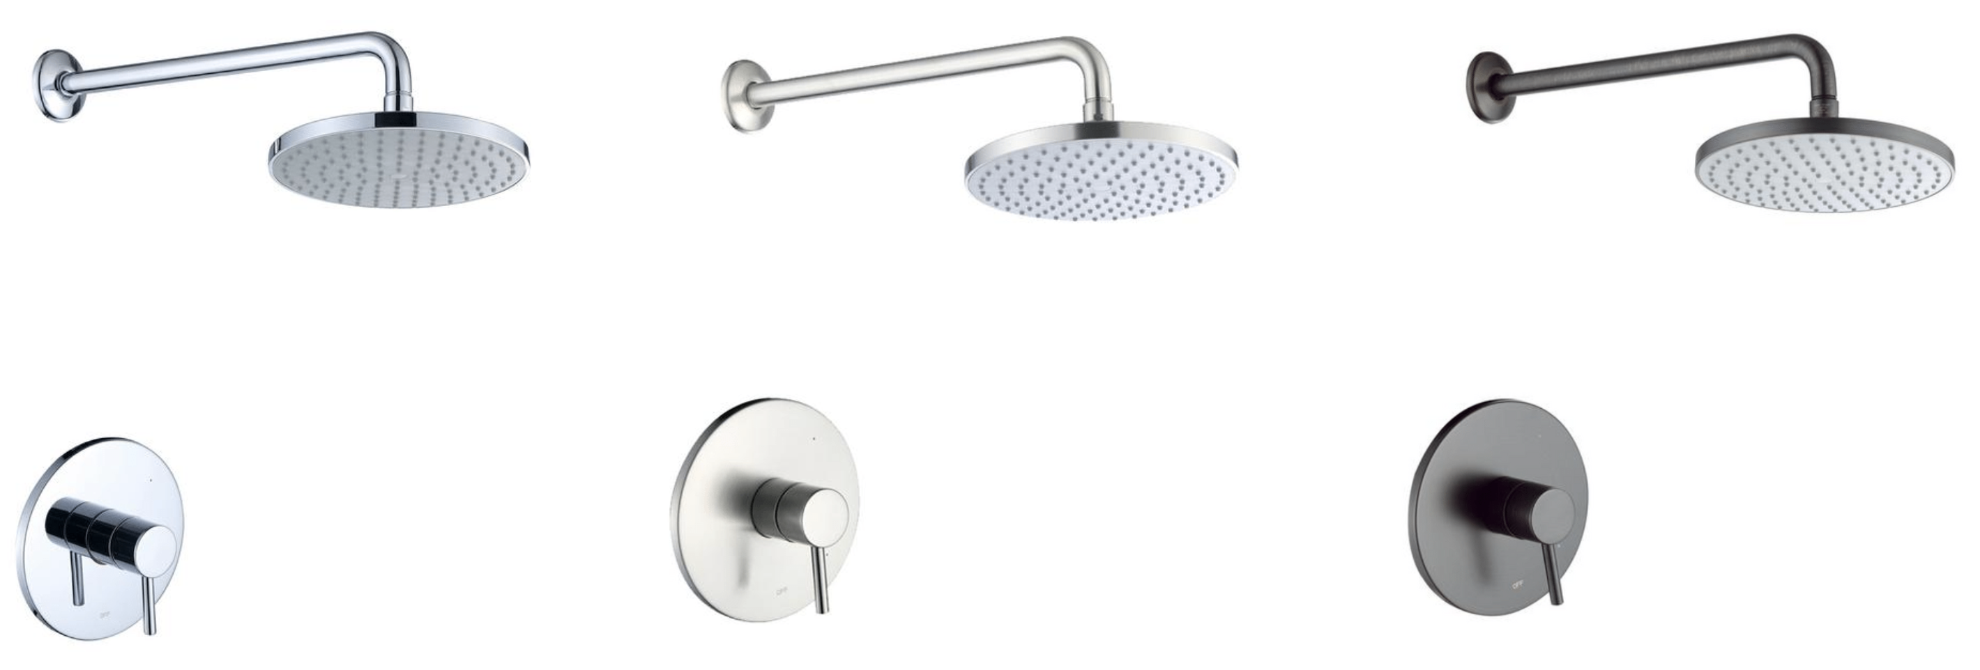
SHOWER PLUMBING FIXTURES – ADD ON/UPGRADE LEVEL 2
Single-Handle 1-Spray Shower Faucet with Valve in Chrome (Valve Included)
Single-Handle 1-Spray Shower Faucet with Valve in Brushed Nickel (Valve Included)
Single-Handle 1-Spray Shower Faucet with Valve in Oil Rubbed Bronze (Valve Included)

Slide 20
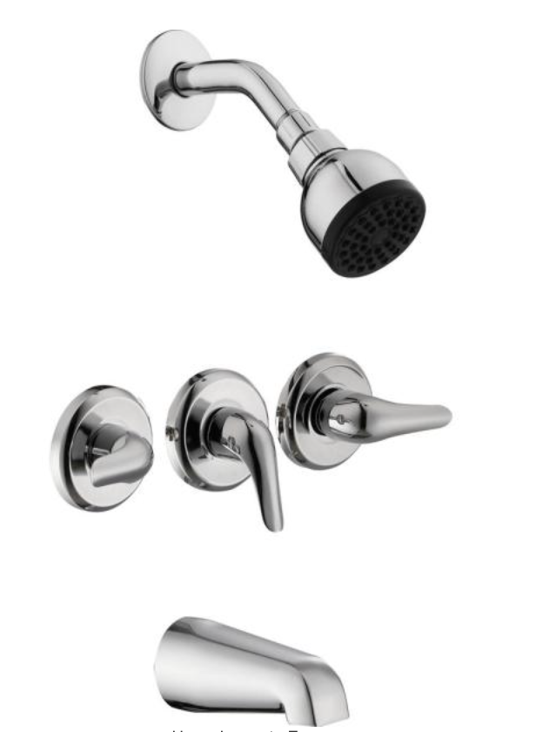
TUB PLUMBING FIXTURES – INCLUDED IN PACKAGE
INCLUDED -
3-Handle 1-Spray Tub and Shower Faucet in Chrome (Valve Included)

Slide 21
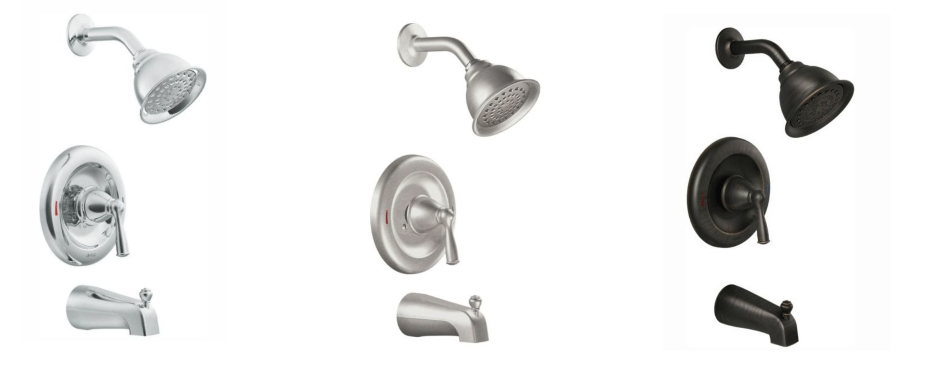
TUB PLUMBING FIXTURES – FREE UPGRADE
Single-Handle 1-Spray 1.75 GPM Tub and Shower Faucet with Valve in Chrome (Valve Included)
Single-Handle 1-Spray 1.75 GPM Tub and Shower Faucet with Valve in Spot Resist Brushed Nickel (Valve Included)
Single-Handle 1-Spray 1.75 GPM Tub and Shower Faucet with Valve in Mediterranean Bronze (Valve Included)

Slide 22
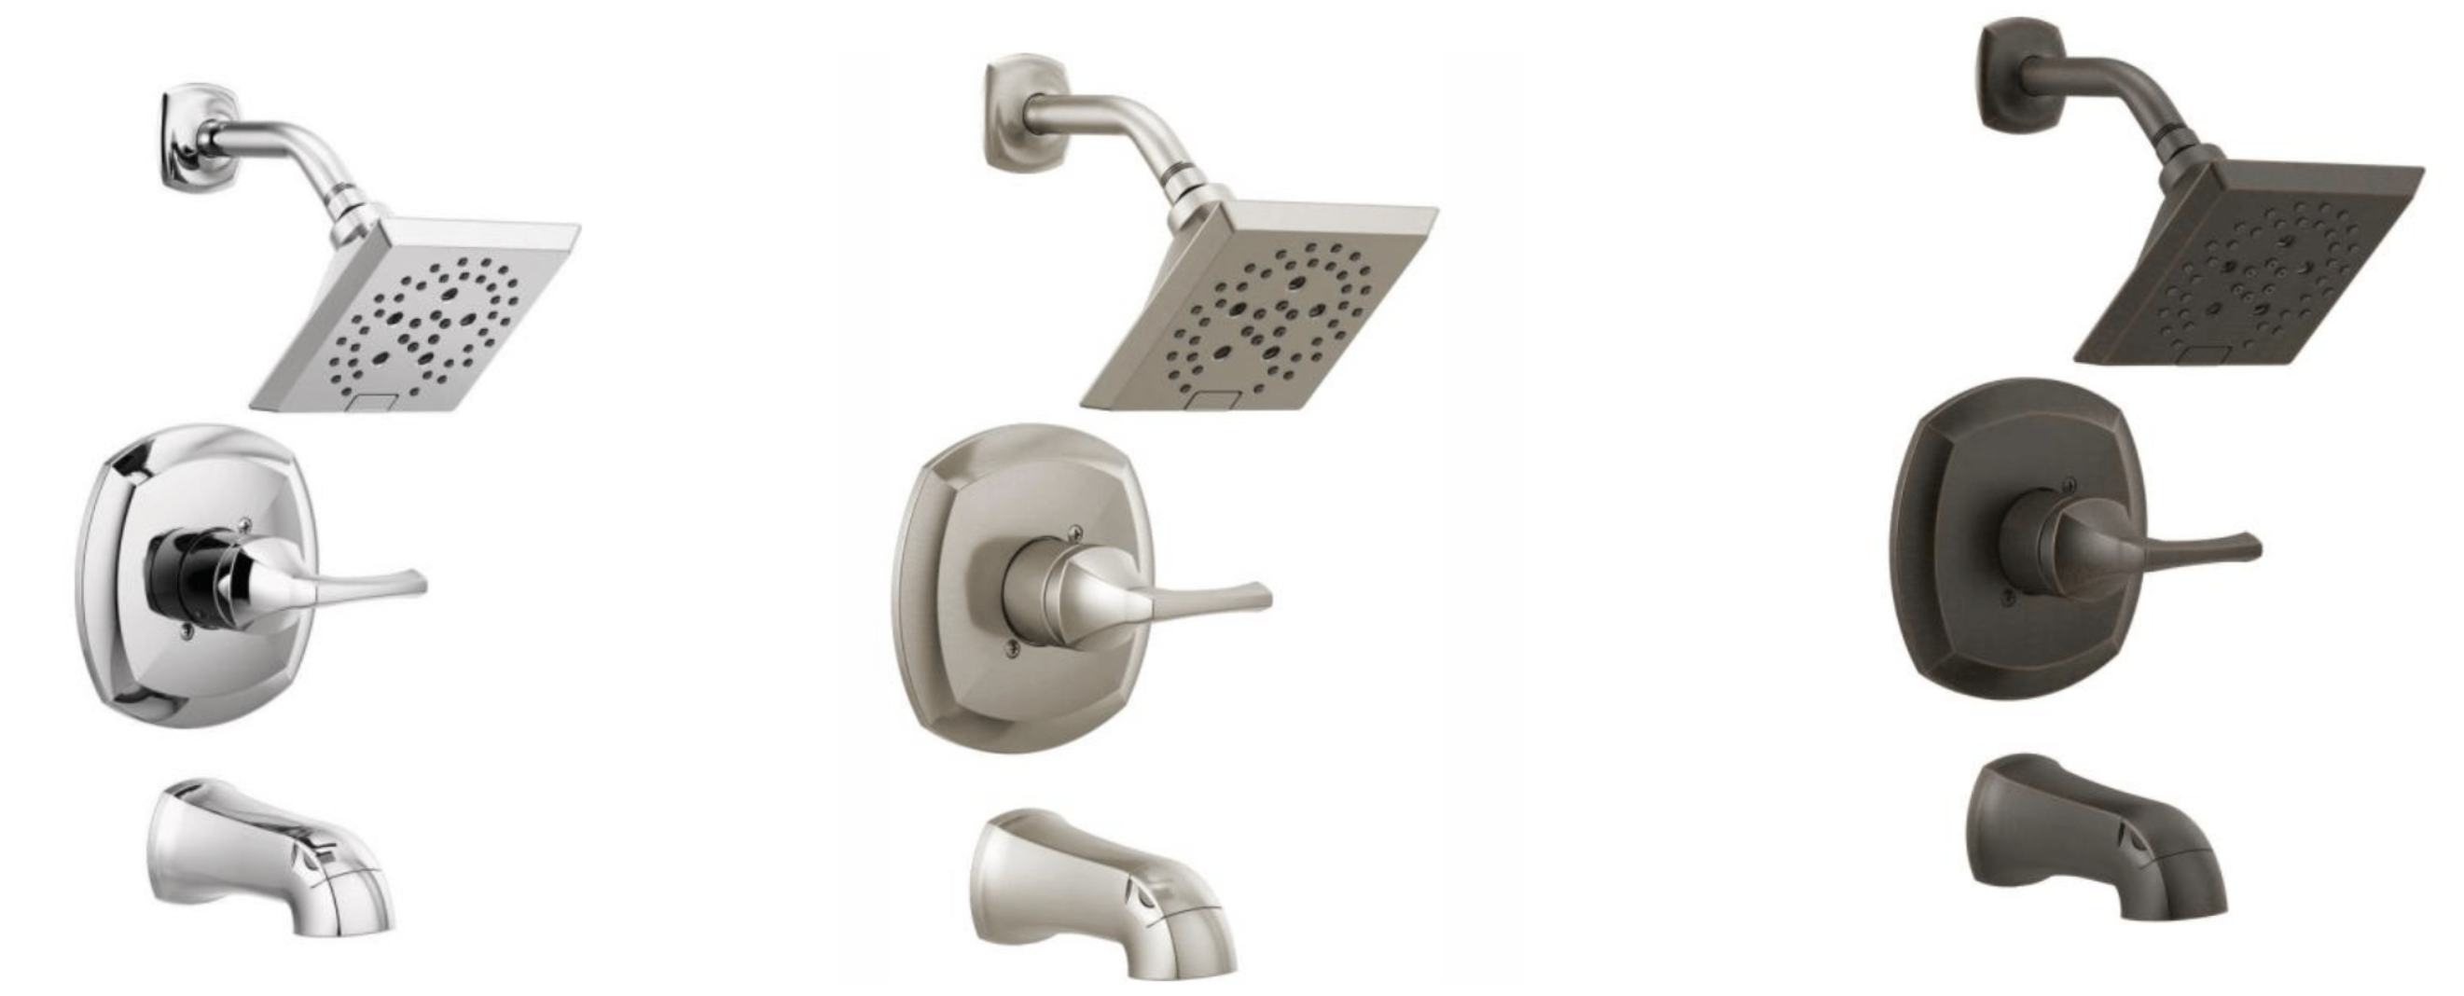
TUB PLUMBING FIXTURES – ADD ON/UPGRADE LEVEL 2
Single-Handle 5-Spray Tub and Shower Faucet with H2Okinetic in Chrome (Valve Included)
Single-Handle 5-Spray Tub and Shower Faucet with H2Okinetic in SpotShield Brushed Nickel (Valve Included)
Single-Handle 5-Spray Tub and Shower Faucet with H2Okinetic in Venetian Bronze (Valve Included)

Slide 23
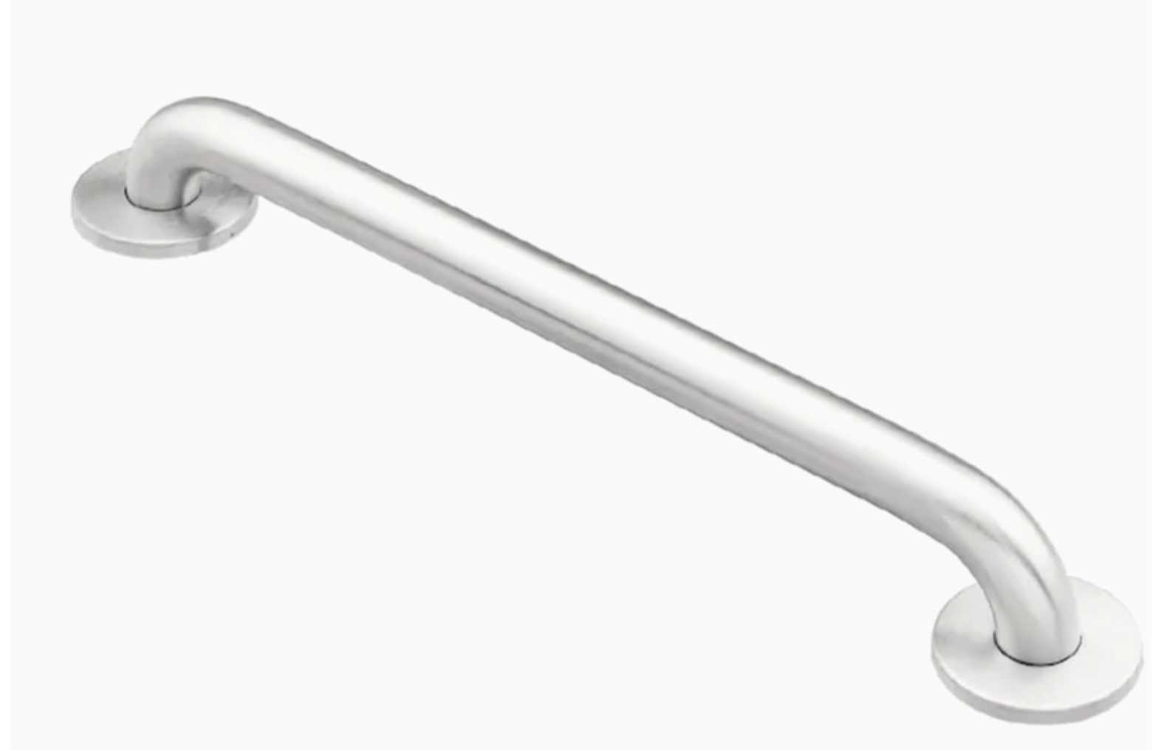
ACCESSORIES: GRAB BAR – INCLUDED IN PACKAGE
INCLUDED -
18-in Stainless Steel Wall Mount (ADA Compliant) Grab Bar
Notes:
*** NOT INCLUDED IN CORNER

Slide 24
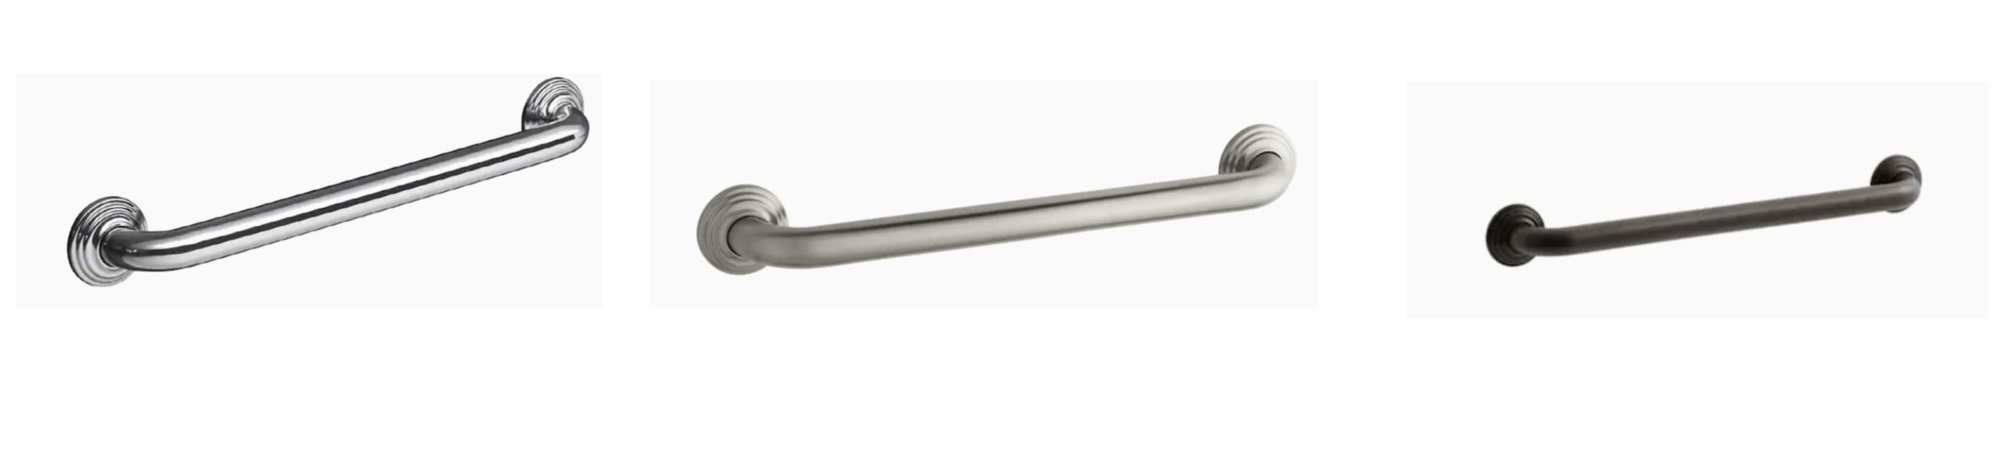
ACCESSORIES: GRAB BARS – ADD ON/UPGRADE LEVEL 2
Traditional 18-in Polished Stainless Wall Mount Grab Bar -
Traditional 18-in Vibrant Brushed Nickel Wall Mount Grab Bar -
Traditional 18-in Oil-Rubbed Bronze Wall Mount (ADA Compliant) Grab Bar -
Notes:
*** NOT INCLUDED IN CORNER

Slide 25
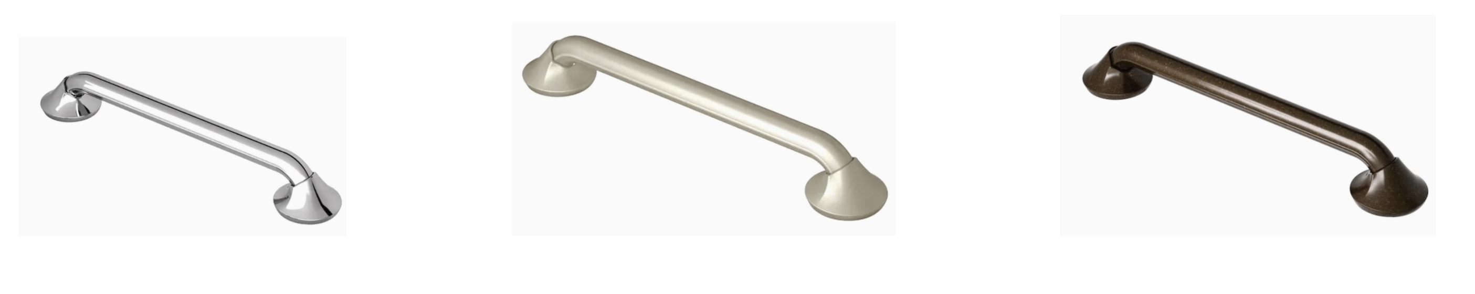
ACCESSORIES: GRAB BARS – ADD ON/UPGRADE LEVEL 3
18-in Chrome Wall Mount (ADA Compliant) Grab Bar -
18-in Brushed Nickel Wall Mount (ADA Compliant) Grab Bar
18-in Oil Rubbed Bronze Wall Mount (ADA Compliant) Grab Bar
Notes:
*** NOT INCLUDED IN CORNER

Slide 26
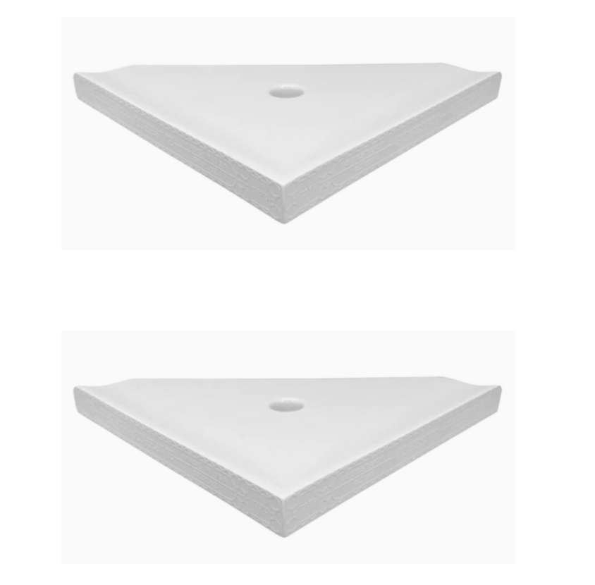
ACCESSORIES: CORNER SHELVES – INCLUDED IN PACKAGE
8" bright white polished corner shelf Bright White 1-Tier Ceramic Wall Mount Bathroom Shelf
Notes:
*** NOT INCLUDED IN CORNER

Slide 27
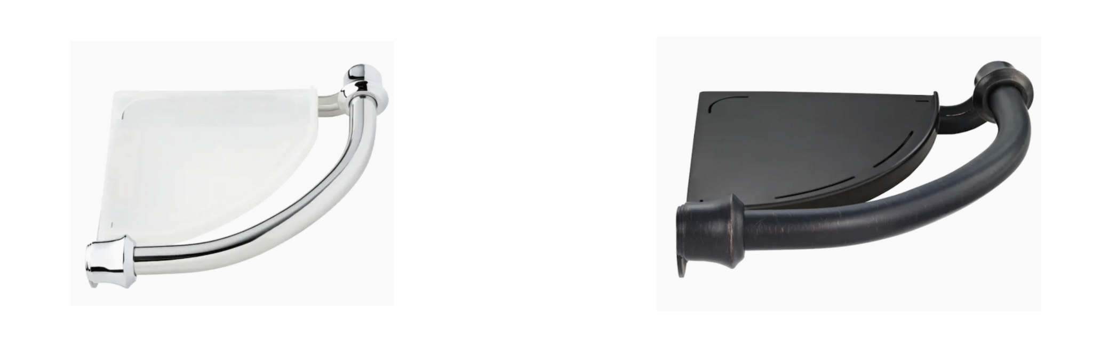
ACCESSORIES: CORNER SHELVES – ADD ON LEVEL 2
Traditional 8.92-in Polished Chrome Wall Mount Grab Bar
- $45.65/ea
8.92-in Venetian Bronze Wall Mount Grab Bar
- $78.33/ea
https://www.lowes.com/pd/Delta-Traditional-8-92-in-Polished-Chrome-Wall-Mount-Grab-Bar/1000215171
https://www.lowes.com/pd/Delta-Traditional-8-92-in-Venetian-Bronze-Wall-Mount-Grab-Bar/1000213865
Notes:
INCLUDED IN CORNER WITH PACKAGE – ADD ON FOR TUB/ALCOVE

Slide 28
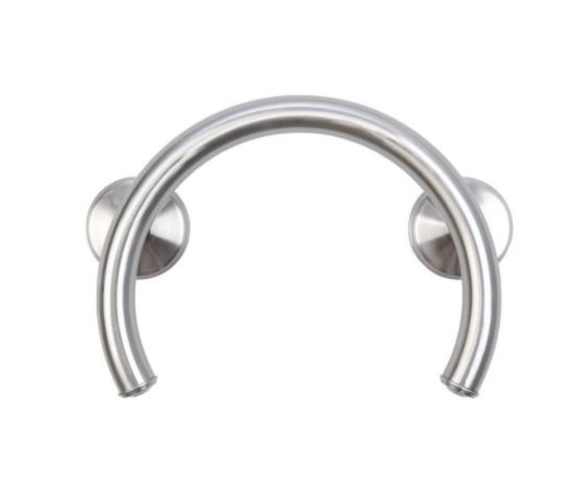
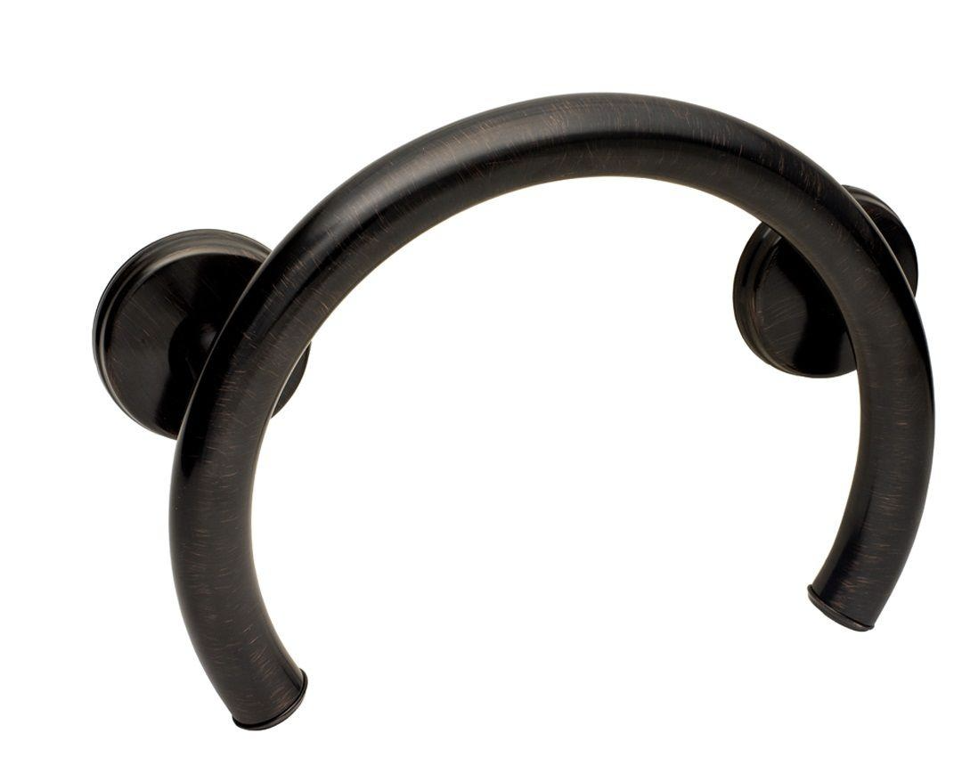
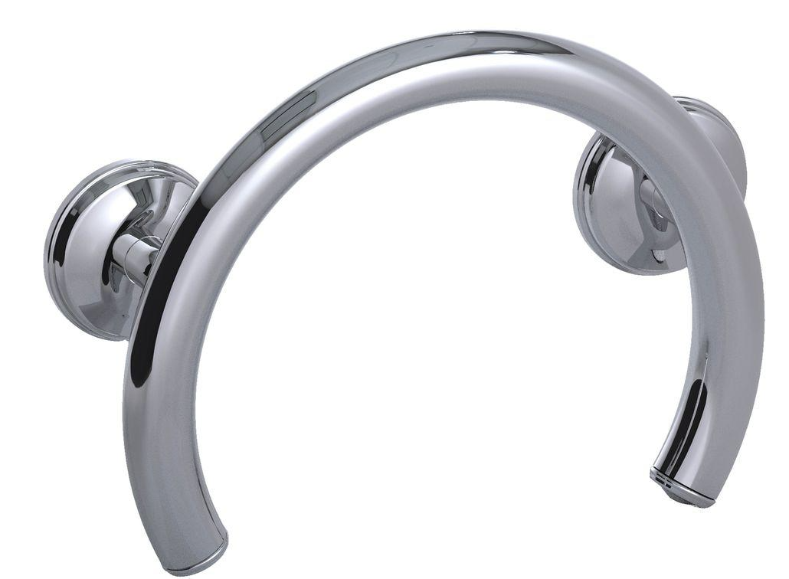
CORNER ACCESSORIES: GRAB BARS – ADD ON/UPGRADE LEVEL 2
2-in-1 13.25 in. x 1.25 in. Shower and Tub Grab Ring with Grips in Chrome -
13.25 in. x 1.25 in. Shower and Tub Grab Ring with Grips in Brushed Nickel-
2-in-1 13.25 in. x 1.25 in. Shower and Tub Grab Ring with Grips in Oil Rubbed Bronze
Notes:
UPGRADE FOR CORNER

Slide 29
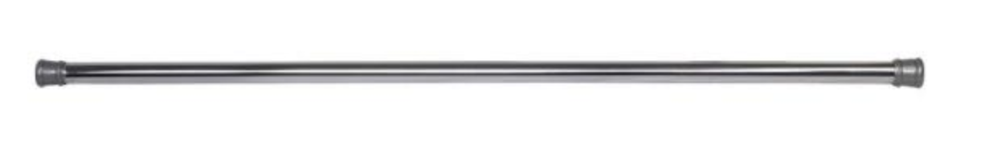
ACCESSORIES: CURTAIN ROD – INCLUDED IN PACKAGE
INCLUDED -
43 in. to 72 in. Steel Adjustable Shower Curtain Rod in Chrome
Notes:
*** NOT INCLUDED IN CORNER

Slide 30
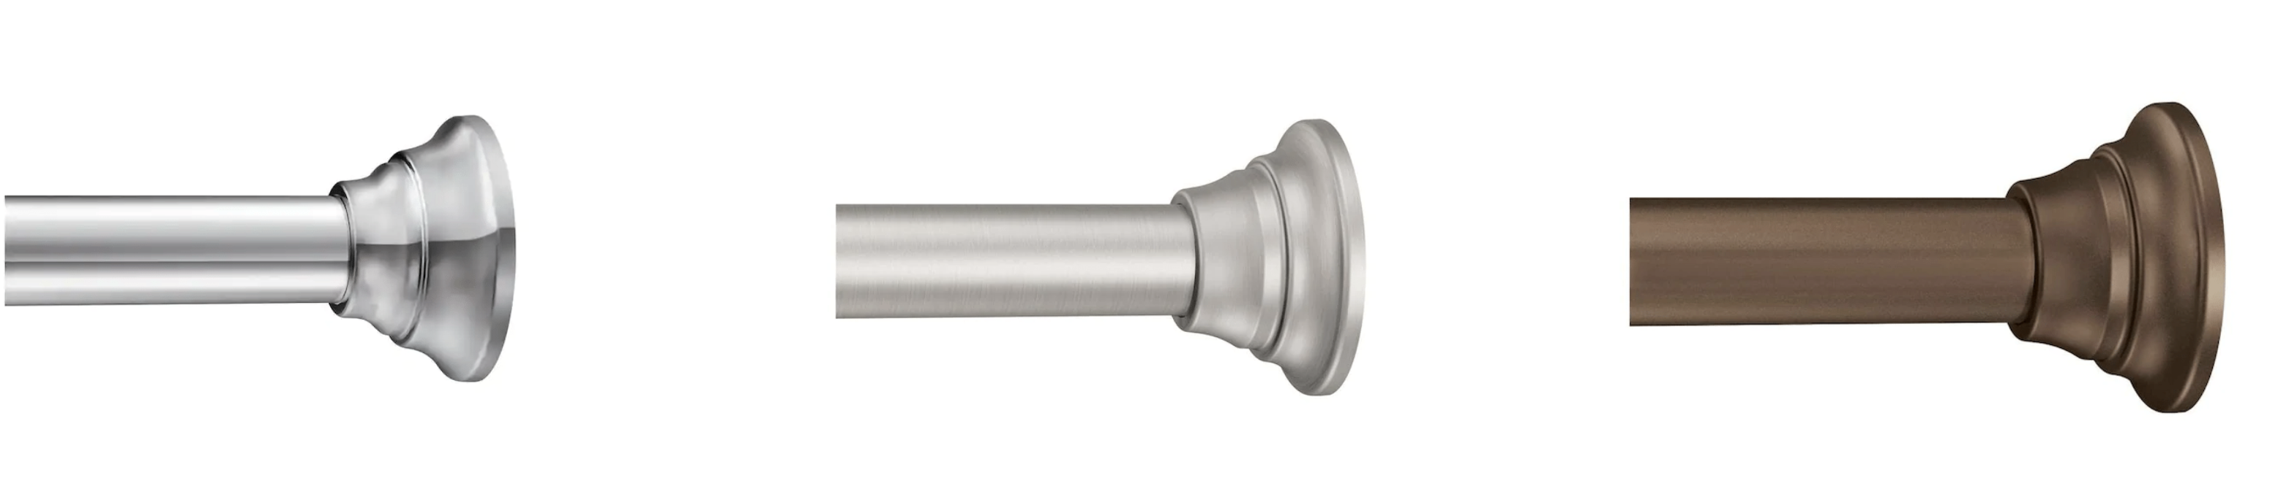
ACCESSORIES: CURTAIN ROD – ADD ON/UPGRADE LEVEL 2
44-in to 72-in Brushed Nickel Tension Single Straight Shower Rod
44-in to 72-in Brushed Nickel Tension Single Straight Shower Rod
44-in to 72-in Old World Bronze Tension Single Straight Shower Rod
Notes:
*** NOT INCLUDED IN CORNER

Slide 31
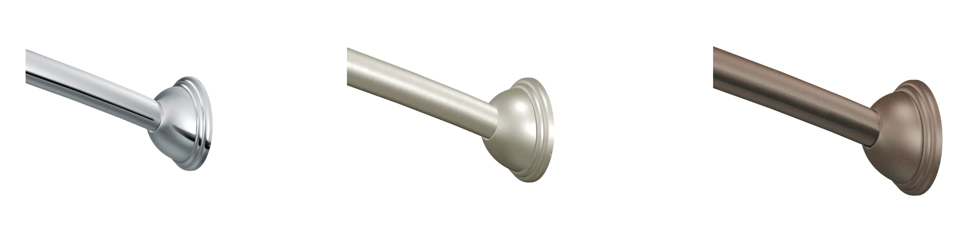
ACCESSORIES: CURTAIN ROD – CURVED - ADD ON/UPGRADE LEVEL 3
59-in to 60-in Chrome Fixed Single Curve Shower Rod
59-in to 60-in Brushed Nickel Fixed Single Curve Shower Rod
59-in to 60-in Old World Bronze Fixed Single Curve Shower Rod
Notes:
*** NOT INCLUDED IN CORNER

Slide 32
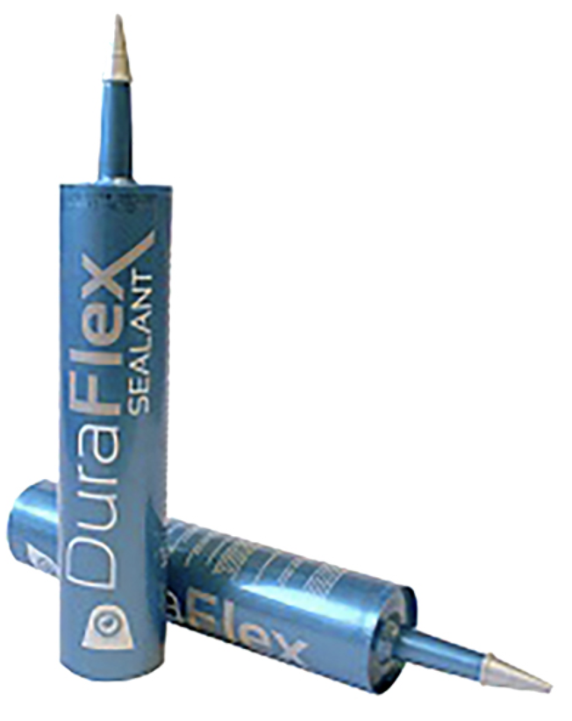
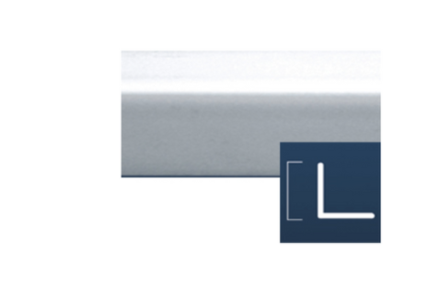
Included – Sealant & Adhesive
Notes:
Can this be automatically selected? It’s part of all the packages

Slide 33
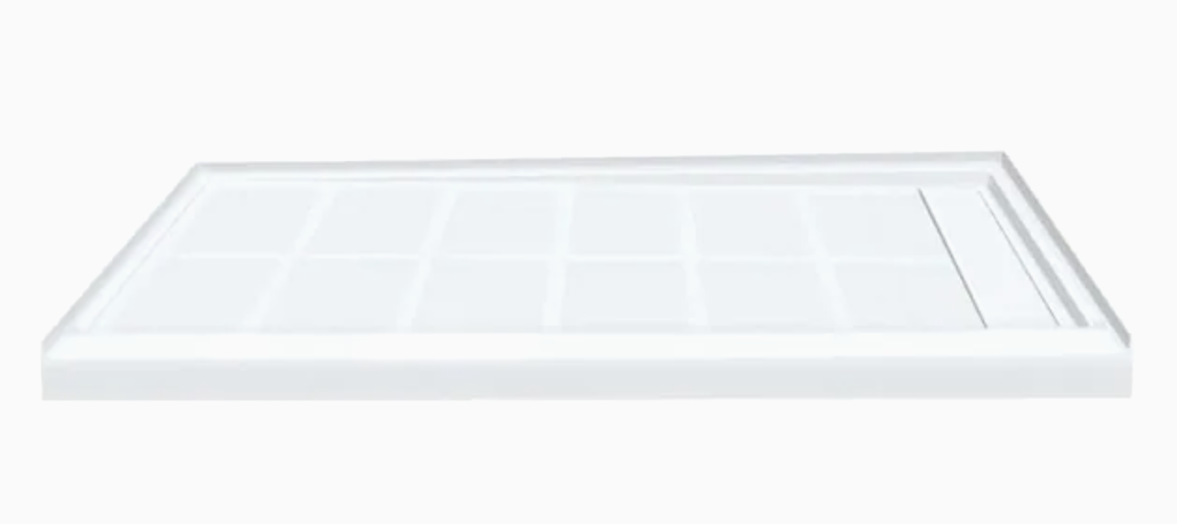

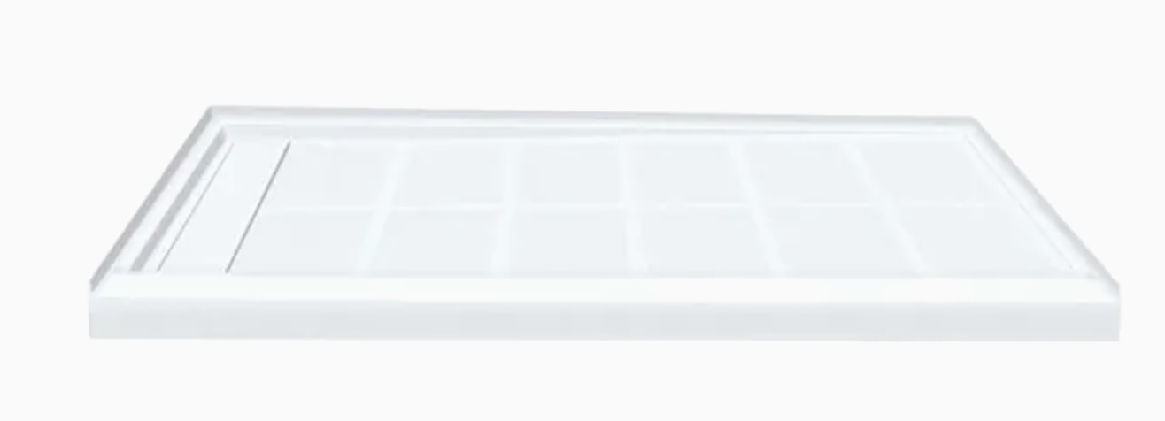
ADD ON – SOLID SURFACE BASE
White Solid Surface Shower Base 32-in W x 60-in L with Left or Right Drain - $330
36 in. L x 60 in. W Alcove Shower Pan Base with Center Drain in White - $480
https://www.homedepot.com/p/Transolid-Linear-36-in-L-x-60-in-W-Alcove-Shower-Pan-Base-with-Center-Drain-in-White-FL6036C-31/315551202?NCNI-5
https://www.lowes.com/pd/Transolid-Linear-White-Solid-Surface-Shower-Base-32-in-W-x-60-in-L-with-Left-Drain/1001094322

Slide 34
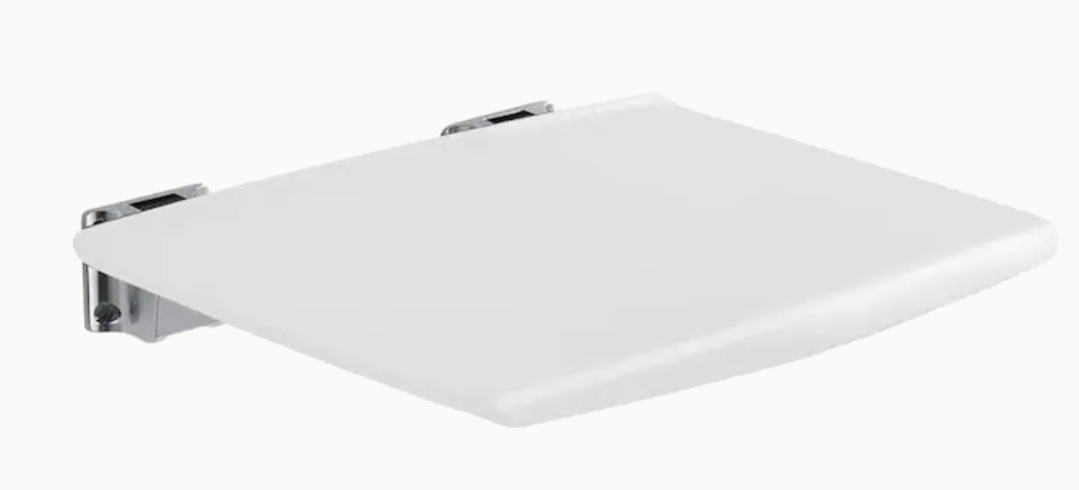
ADD ON – Seat

Slide 35
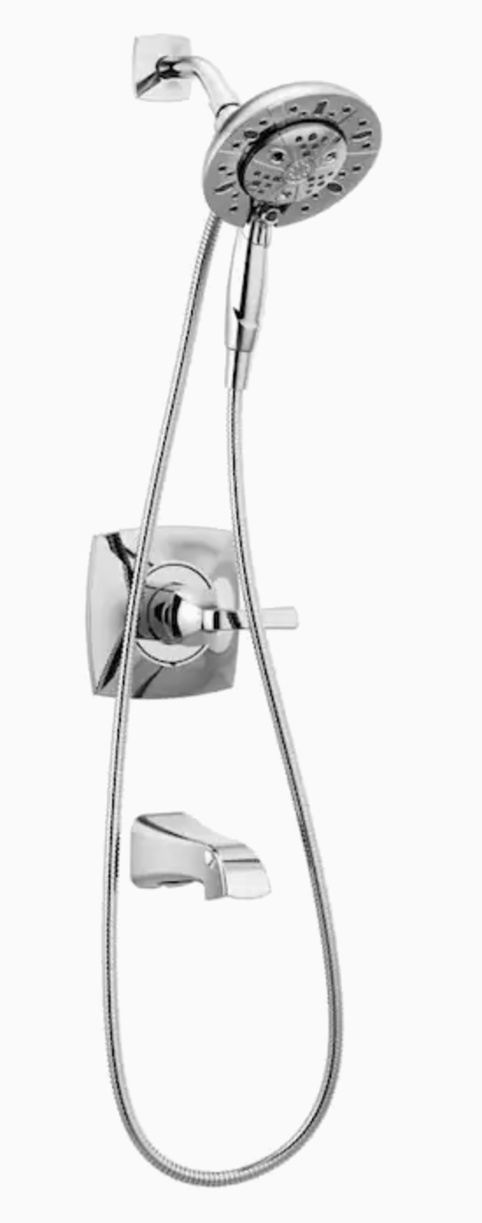
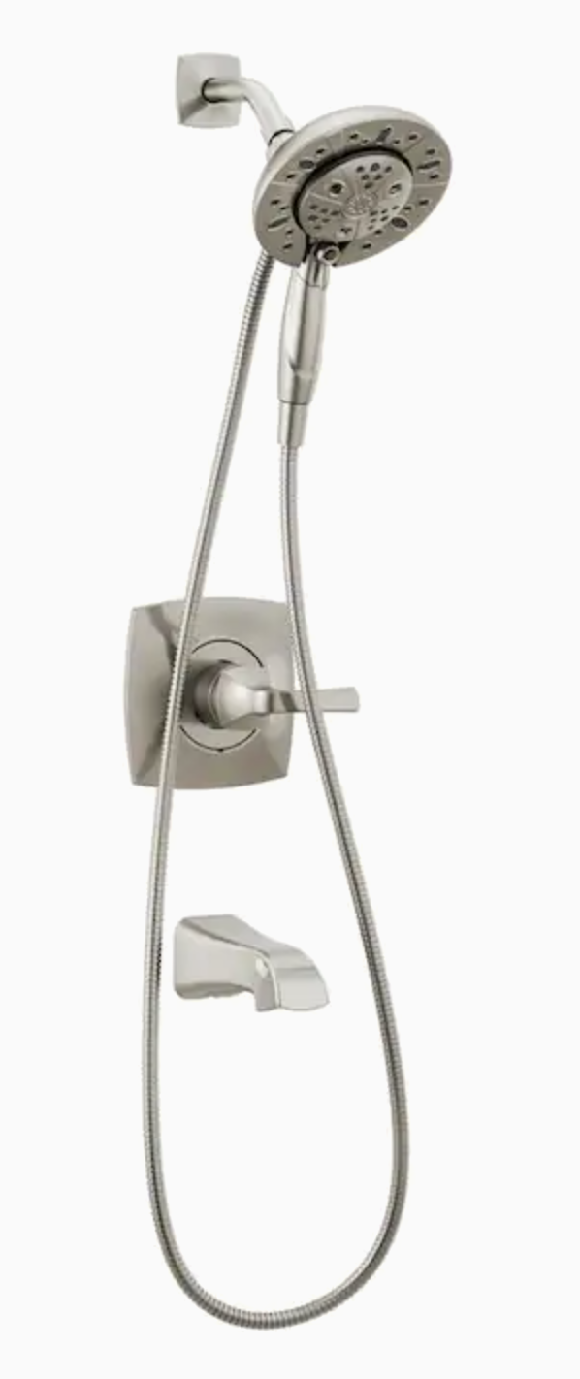
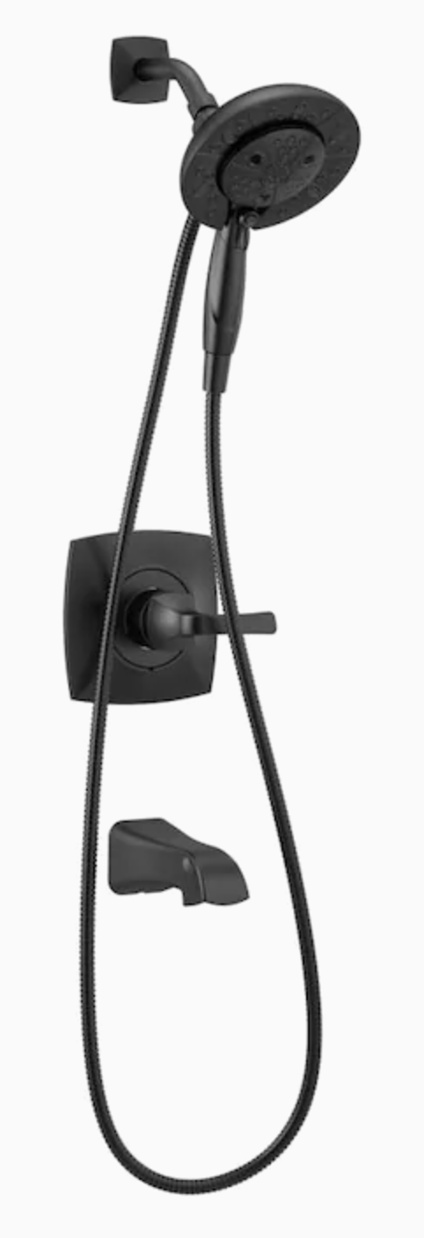
ADD ON – HANDHELD PLUMBING FIXTURE
Chrome 1-Handle Bathtub and Shower Faucet with Valve - $269.34
Spotshield Stainless 1-Handle Bathtub and Shower Faucet with Valve - $289.41
Matte Black 1-Handle Bathtub and Shower Faucet with Valve - $288.83
https://www.lowes.com/pd/Delta-Faucet-Vesna-Chrome-1-Handle-Bathtub-and-Shower-Faucet-with-Valve/1002622656
https://www.lowes.com/pd/Delta-Faucet-Vesna-Spotshield-Brushed-Nickel-1-Handle-Bathtub-and-Shower-Faucet-with-Valve/1002622660
https://www.lowes.com/pd/Delta-Faucet-Vesna-Matte-Black-1-Handle-Bathtub-and-Shower-Faucet-with-Valve/1002622676

Slide 36
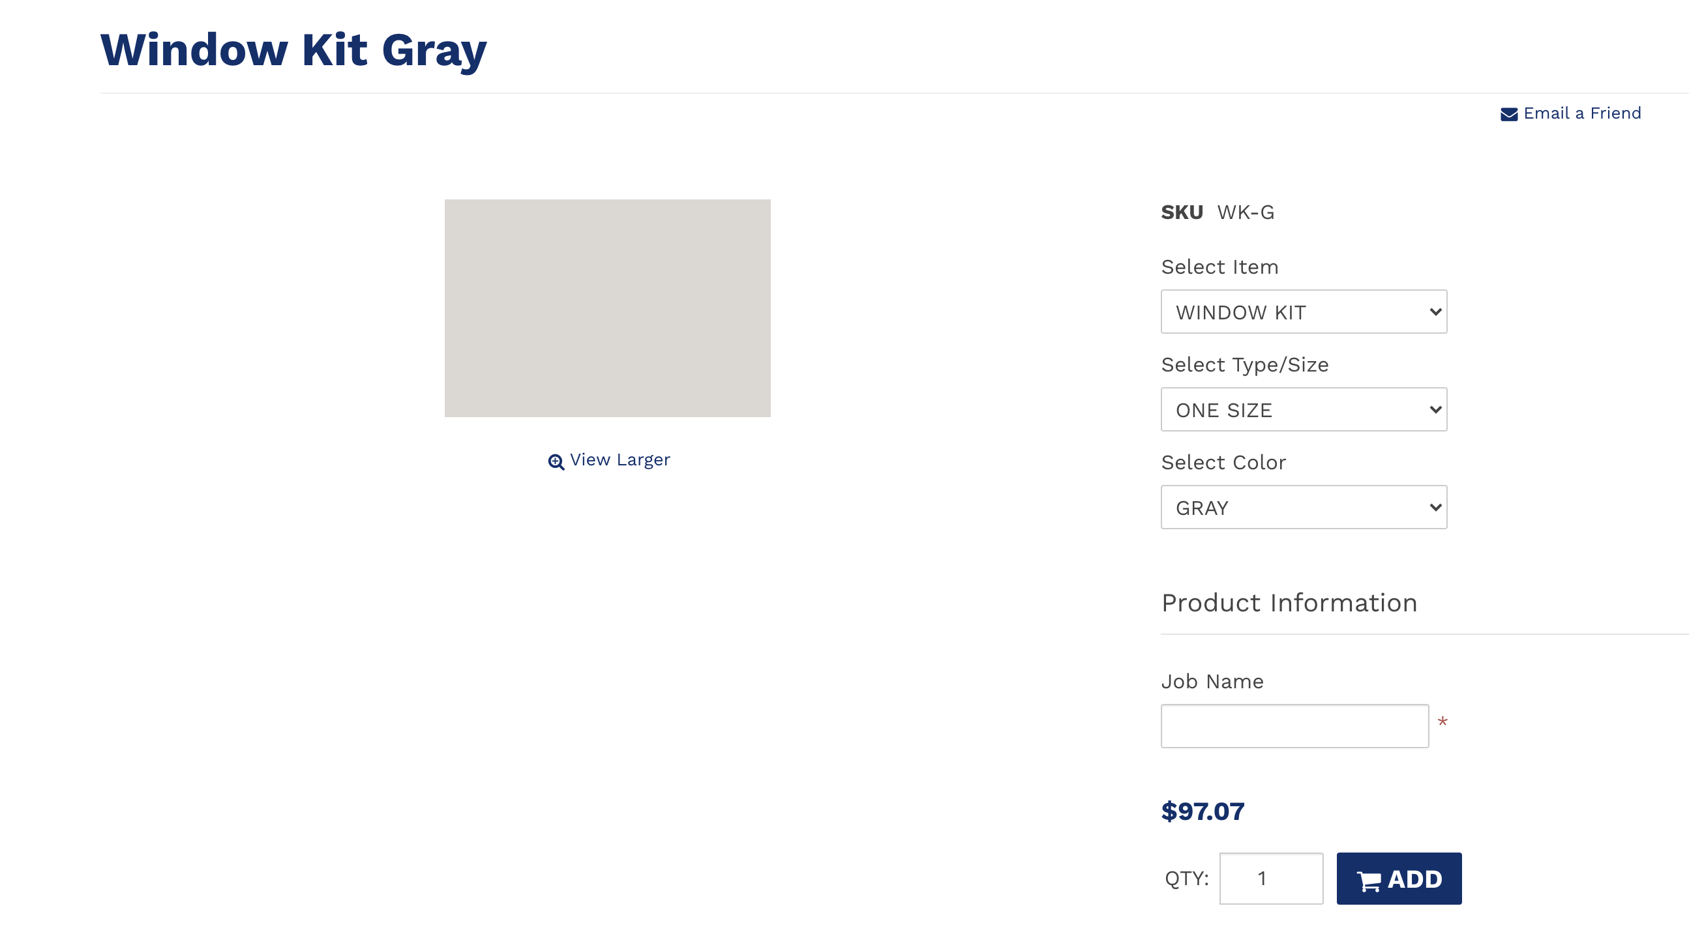
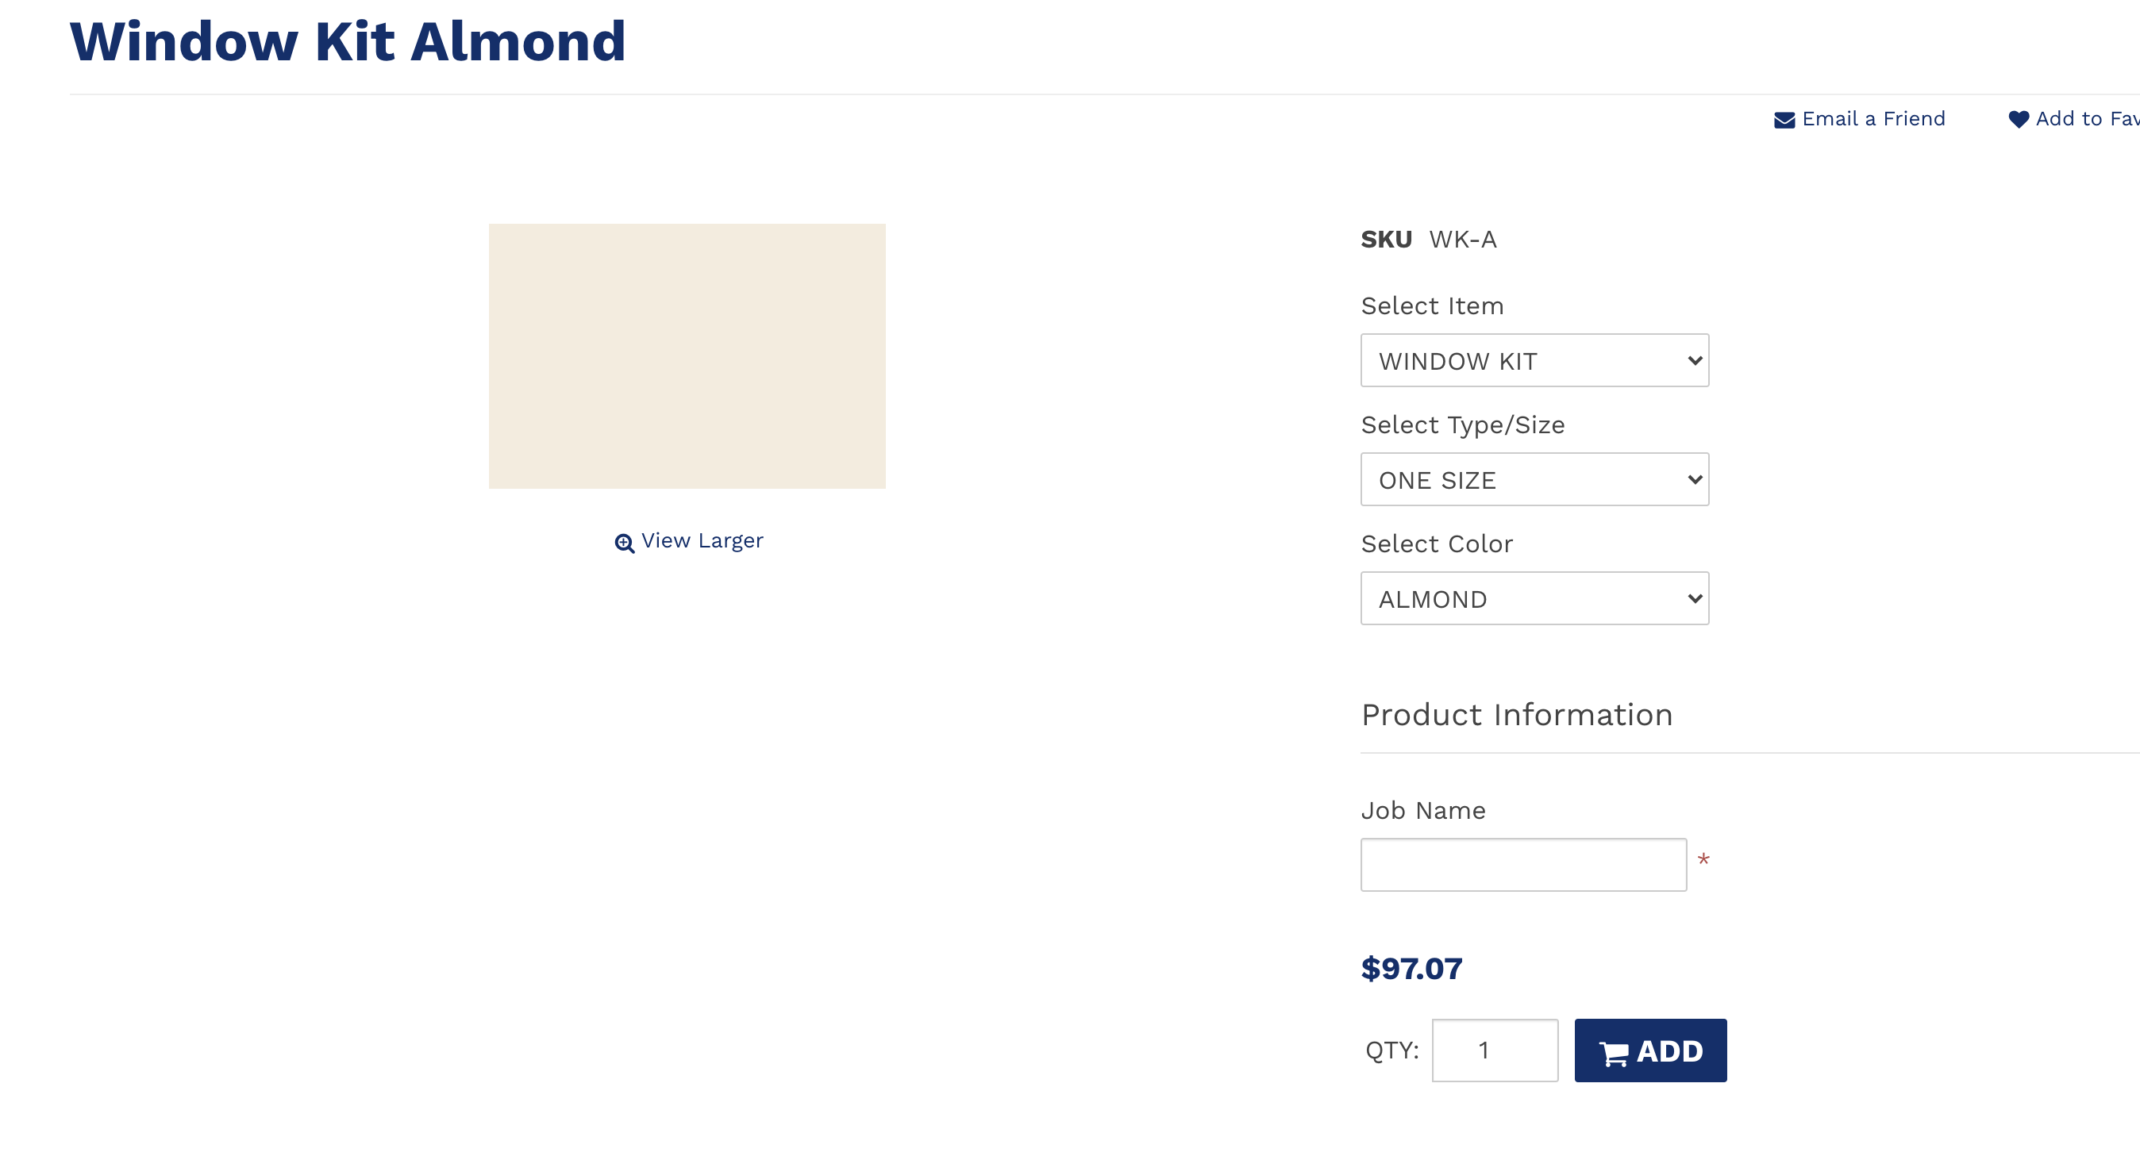
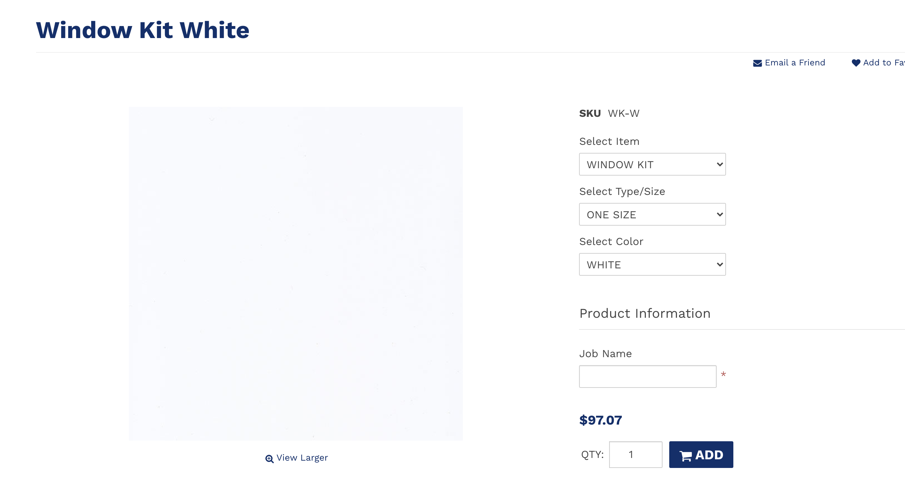
ADD ON – WINDOW KIT – SELECT COLOR:
GRAY
ALMOND
WHITE

